Slide 1
SER 334 A Session
Exam 1 Review Session
Thursday, January 25th 2024
7:00 pm - 9:00 pm MST

Slide 2
{
Agenda
Pointer Tracing
Sample Problems
Practice Exam

Slide 3
SI Session Expectations
Thanks for coming to the SER 334 SI session. We have a packed agenda and we are going to try to get through as many of our planned example problems as possible. This session will be recorded and shared with others.
If after this you want to see additional examples, please visit the drop-in tutoring center.
We will post the link in the chat now and at the end of the session.
tutoring.asu.edu
Please keep in mind we are recording this session and it will be made available for you to review 24-48 hours after this session concludes.
Finally, please be respectful to each other during the session.

Slide 4

Interact with us:
Zoom Features
Zoom Chat
Use the chat feature to interact with the presenter and respond to presenter’s questions.
Annotations are encouraged

Slide 5

SER 334
Exam Tips
Read each question carefully
Use the scratch spaces!!
These Exams are testing your knowledge in addition to your ability to prioritize tasks and manage your time
Don’t spend too much time on one question!
If you get stuck, select the answer you think and mark the question
Come back after the programming questions to re-attempt
Pay attention to the clock!
Make sure to leave yourself enough time for programming!

Slide 6
Unit 1, Question 8
a
Add
1 int a, *b, **c, d;
2 a = 5;
3 d = a + 1;
4 b = &a;
5 c = &b
6 // Point 1
7 *b = 8;
8 b = &d;
9 **c = 3;
10 // Point 2
11 b+=7;
12 // Point 3
&a
Val
SER 334
b
Add
Sample Review
&b
Val
c
Add
&c
Val
d
Add
&d
Val
Type | int | int (deref) | int pointer | int pointer (deref) | int double pointer | int
Var Name | a | *b | b | *c | c | d
Point 1
Point 2
Point 3

Slide 7
Unit 1, Question 8
a
Add
1 int a, *b, **c, d;
2 a = 5;
3 d = a + 1;
4 b = &a;
5 c = &b
6 // Point 1
7 *b = 8;
8 b = &d;
9 **c = 3;
10 // Point 2
11 b+=7;
12 // Point 3
&a
Val
SER 334
b
Add
Sample Review
&b
Val
c
Add
&c
Val
d
Add
&d
Val
Type | int | int (deref) | int pointer | int pointer (deref) | int double pointer | int
Var Name | a | *b | b | *c | c | d
Point 1
Point 2
Point 3

Slide 8
Unit 1, Question 8
a
Add
1 int a, *b, **c, d;
2 a = 5;
3 d = a + 1;
4 b = &a;
5 c = &b
6 // Point 1
7 *b = 8;
8 b = &d;
9 **c = 3;
10 // Point 2
11 b+=7;
12 // Point 3
&a
Val
SER 334
5
b
Add
Sample Review
&b
Val
c
Add
&c
Val
d
Add
&d
Val
Type | int | int (deref) | int pointer | int pointer (deref) | int double pointer | int
Var Name | a | *b | b | *c | c | d
Point 1 | 5 | 5 | Add. of a | Add. of a | Add. of b | 6
Point 2
Point 3

Slide 9
Unit 1, Question 8
a
Add
1 int a, *b, **c, d;
2 a = 5;
3 d = a + 1;
4 b = &a;
5 c = &b
6 // Point 1
7 *b = 8;
8 b = &d;
9 **c = 3;
10 // Point 2
11 b+=7;
12 // Point 3
&a
Val
SER 334
5
b
Add
Sample Review
&b
Val
c
Add
&c
Val
d
Add
&d
Val
6
Type | int | int (deref) | int pointer | int pointer (deref) | int double pointer | int
Var Name | a | *b | b | *c | c | d
Point 1 | 5 | 5 | Add. of a | Add. of a | Add. of b | 6
Point 2
Point 3

Slide 10
Unit 1, Question 8
a
Add
1 int a, *b, **c, d;
2 a = 5;
3 d = a + 1;
4 b = &a;
5 c = &b
6 // Point 1
7 *b = 8;
8 b = &d;
9 **c = 3;
10 // Point 2
11 b+=7;
12 // Point 3
&a
Val
SER 334
5
*b
b
Add
Sample Review
&b
Val
&a
c
Add
&c
Val
d
Add
&d
Val
6
Type | int | int (deref) | int pointer | int pointer (deref) | int double pointer | int
Var Name | a | *b | b | *c | c | d
Point 1 | 5 | 5 | Add. of a | Add. of a | Add. of b | 6
Point 2
Point 3

Slide 11
Unit 1, Question 8
a
Add
1 int a, *b, **c, d;
2 a = 5;
3 d = a + 1;
4 b = &a;
5 c = &b
6 // Point 1
7 *b = 8;
8 b = &d;
9 **c = 3;
10 // Point 2
11 b+=7;
12 // Point 3
&a
Val
SER 334
5
*b
b
Add
Sample Review
&b
Val
&a
c
Add
*c
&c
Val
&b
d
Add
&d
Val
6
Type | int | int (deref) | int pointer | int pointer (deref) | int double pointer | int
Var Name | a | *b | b | *c | c | d
Point 1 | 5 | 5 | Add. of a | Add. of a | Add. of b | 6
Point 2
Point 3

Slide 12
Unit 1, Question 8
a
Add
1 int a, *b, **c, d;
2 a = 5;
3 d = a + 1;
4 b = &a;
5 c = &b
6 // Point 1
7 *b = 8;
8 b = &d;
9 **c = 3;
10 // Point 2
11 b+=7;
12 // Point 3
&a
Val
SER 334
5
*b
b
Add
Sample Review
&b
Val
&a
c
Add
*c
&c
Val
&b
d
Add
&d
Val
6
Type | int | int (deref) | int pointer | int pointer (deref) | int double pointer | int
Var Name | a | *b | b | *c | c | d
Point 1 | 5 | 5 | Add. of a | Add. of a | Add. of b | 6
Point 2
Point 3

Slide 13
Unit 1, Question 8
a
Add
1 int a, *b, **c, d;
2 a = 5;
3 d = a + 1;
4 b = &a;
5 c = &b
6 // Point 1
7 *b = 8;
8 b = &d;
9 **c = 3;
10 // Point 2
11 b+=7;
12 // Point 3
&a
Val
5
SER 334
8
*b
b
Add
Sample Review
&b
Val
&a
c
Add
*c
&c
Val
&b
d
Add
&d
Val
3
6
Type | int | int (deref) | int pointer | int pointer (deref) | int double pointer | int
Var Name | a | *b | b | *c | c | d
Point 1 | 5 | 5 | Add. of a | Add. of a | Add. of b | 6
Point 2 | 8 | 3 | Add. of d | Add. of d | Add. of b | 3
Point 3

Slide 14
Unit 1, Question 8
a
Add
1 int a, *b, **c, d;
2 a = 5;
3 d = a + 1;
4 b = &a;
5 c = &b
6 // Point 1
7 *b = 8;
8 b = &d;
9 **c = 3;
10 // Point 2
11 b+=7;
12 // Point 3
&a
Val
SER 334
8
*b
b
Add
Sample Review
&b
Val
&a
&d
c
Add
*c
&c
Val
&b
*b
d
Add
&d
Val
3
6
Type | int | int (deref) | int pointer | int pointer (deref) | int double pointer | int
Var Name | a | *b | b | *c | c | d
Point 1 | 5 | 5 | Add. of a | Add. of a | Add. of b | 6
Point 2 | 8 | 3 | Add. of d | Add. of d | Add. of b | 3
Point 3

Slide 15
Unit 1, Question 8
a
Add
1 int a, *b, **c, d;
2 a = 5;
3 d = a + 1;
4 b = &a;
5 c = &b
6 // Point 1
7 *b = 8;
8 b = &d;
9 **c = 3;
10 // Point 2
11 b+=7;
12 // Point 3
&a
Val
SER 334
8
b
Add
Sample Review
&b
Val
&d
c
Add
*c
&c
Val
&b
*b
d
Add
&d
Val
3
6
Type | int | int (deref) | int pointer | int pointer (deref) | int double pointer | int
Var Name | a | *b | b | *c | c | d
Point 1 | 5 | 5 | Add. of a | Add. of a | Add. of b | 6
Point 2 | 8 | 3 | Add. of d | Add. of d | Add. of b | 3
Point 3

Slide 16
Unit 1, Question 8
a
Add
1 int a, *b, **c, d;
2 a = 5;
3 d = a + 1;
4 b = &a;
5 c = &b
6 // Point 1
7 *b = 8;
8 b = &d;
9 **c = 3;
10 // Point 2
11 b+=7;
12 // Point 3
&a
Val
SER 334
8
b
Add
Sample Review
&b
Val
&d
c
Add
*c
&c
Val
&b
*b
d
Add
&d
Val
3
Type | int | int (deref) | int pointer | int pointer (deref) | int double pointer | int
Var Name | a | *b | b | *c | c | d
Point 1 | 5 | 5 | Add. of a | Add. of a | Add. of b | 6
Point 2 | 8 | 3 | Add. of d | Add. of d | Add. of b | 3
Point 3

Slide 17
Unit 1, Question 8
a
Add
Add
1 int a, *b, **c, d;
2 a = 5;
3 d = a + 1;
4 b = &a;
5 c = &b
6 // Point 1
7 *b = 8;
8 b = &d;
9 **c = 3;
10 // Point 2
11 b+=7;
12 // Point 3
&a
Val
Val
SER 334
8
b
Add
Sample Review
&b
&d + 7
Val
&d + (7 * 4)
&d
&d + 28
c
Add
*c
&c
Val
&b
*b
d
Add
&d
Val
3
Type | int | int (deref) | int pointer | int pointer (deref) | int double pointer | int
Var Name | a | *b | b | *c | c | d
Point 1 | 5 | 5 | Add. of a | Add. of a | Add. of b | 6
Point 2 | 8 | 3 | Add. of d | Add. of d | Add. of b | 3
Point 3 |  | Value @ &d + (7*4) | &d + (7*4) | &d + (7*4)

Slide 18
Unit 1, Question 8
a
Add
Add
1 int a, *b, **c, d;
2 a = 5;
3 d = a + 1;
4 b = &a;
5 c = &b
6 // Point 1
7 *b = 8;
8 b = &d;
9 **c = 3;
10 // Point 2
11 b+=7;
12 // Point 3
&a
&d+28
Val
Val
SER 334
8
??
b
Add
Sample Review
&b
&d + 7
Val
&d + (7 * 4)
&d+28
&d + 28
c
Add
*c
&c
Val
&b
d
Add
&d
Val
3
Type | int | int (deref) | int pointer | int pointer (deref) | int double pointer | int
Var Name | a | *b | b | *c | c | d
Point 1 | 5 | 5 | Add. of a | Add. of a | Add. of b | 6
Point 2 | 8 | 3 | Add. of d | Add. of d | Add. of b | 3
Point 3 |  | Value @ &d + (7*4) | &d + (7*4) | &d + (7*4)

Slide 19
Unit 1, Question 8
a
Add
Add
1 int a, *b, **c, d;
2 a = 5;
3 d = a + 1;
4 b = &a;
5 c = &b
6 // Point 1
7 *b = 8;
8 b = &d;
9 **c = 3;
10 // Point 2
11 b+=7;
12 // Point 3
&a
&d+28
Val
Val
SER 334
8
??
b
Add
Sample Review
&b
&d + 7
Val
&d + (7 * 4)
&d
&d+28
&d + 28
c
Add
*c
&c
Val
&b
*b
d
Add
&d
Val
3
Type | int | int (deref) | int pointer | int pointer (deref) | int double pointer | int
Var Name | a | *b | b | *c | c | d
Point 1 | 5 | 5 | Add. of a | Add. of a | Add. of b | 6
Point 2 | 8 | 3 | Add. of d | Add. of d | Add. of b | 3
Point 3 | 8 | Value @ &d + (7*4) | &d + (7*4) | &d + (7*4) | Add. of b | 3

Slide 20
Practice Exam
w
Add
&w
1 int w = 0, *x = &w, y = 0;
2 // Point 1
3 w = 5;
4 y = -1;
5 // Point 2
6 x = &y;
7 y = 10;
8 w = y + *x;
9 // Point 3
SER 334
Val
Practice Exam
x
Add
&x
Val
y
Add
&y
Val
Type | int | int (deref) | int pointer | int
Var Name | w | *x | x | y
Point 1
Point 2
Point 3

Slide 21
Unit 2, Question 3
SER 334
Sample Review
3. [Acuña] Consider the problem of padding the following structure, and answer the three questions below.
Assume that you are compiling on a system with a 32-bit architecture. [4 points total]
struct bmp_header {
char creator_name[254];
int width;
int height;
char signature_rgb[2];
int offset_pixels;
};
(a) What is the size of this struct as defined?
(b) How much space would be wasted with word length padding?
(c) [Katie] Redefine the structure to reduce the wasted space.

Slide 22
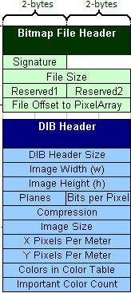
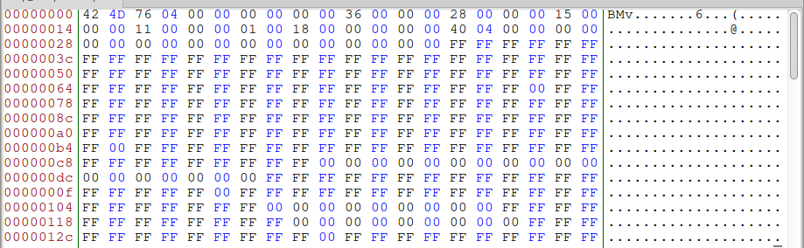
Unit 3, Question 4
SER 334
Sample Review
5. [Acuña] Shown below is a valid BMP file that has been opened in a hex editor. Based on the data visible, answer the following questions. Indicate which number base you use for each question. (The complete specification is shown in the appendix.) Note that this screen shot comes from an Intel architecture system where numbers are stored with little-endian byte ordering
(a) How large is the file?
(b) What is the width and height of this image?
(c) How many bits per pixel are used?
(d) Using b and c, how many bytes are required for each row? How many are for padding?
a)
b)
c)
d)

Slide 23
Practice Exam
SER 334
Practice Exam
2. Consider the following function:
int* getNextUserID() {
int users = db_get_user_count("db1");
static int uid = users + 1;
return &uid;
}
Will the memory allocation in this function work reliably? [5 points]
(a) Yes - it will return an address.
(b) Yes - the memory used by the return value will persist since it is not stack memory.
(c) No - the memory used will be overridden by any new function call the program makes.
(d) No - it will only work some of the time, depending on when getNextUserID is called.

Slide 24
Practice Exam
SER 334
Practice Exam
4. What is the output of the following snippet of code? [5 points]
void update(int *var) {
int new_int = 10;
var = &new_int;
}
void main() {
int num = 20;
int *pointer = &num;
update(pointer);
printf("%d",*pointer);
}
(a) 10
(b) 20
(c) A compiler error
(d) A run-time error

Slide 25
Practice Exam
SER 334
Practice Exam
6. Consider the following snippet of code from Student.c, which defines the class “Student.” Why is the parameter for destroy_student a double pointer? [5 points]
typedef struct student student;
struct student {
char* name;
char* major;
int gpa;
}
void destroy_student(student** s){
free((*s)->name);
free((*s)->major);
free(*s);
*s = NULL;
}
Complete the destroy_student function.

Slide 26
struct grade_node {
int value;
char assignment[255];
struct grade_node* next;
};
Practice Exam
SER 334
Practice Exam
10. The following declaration of a struct is used to represent a node in a linked list of grades. Complete the insert_grades(struct node** head) function. This function needs to read the data from the keyboard and store the values in a new node struct. Then, it adds the new node to the beginning of the linked list. [20 points]
void insert_grades(struct node** head) {

Slide 27
SER 334
Practice Exam

Slide 28
SER 334
Add
a
&a
Exam 1 Review Scratch
Val
Add
b
&b
Val
Add
c
&c
Val
Add
d
&d
Val

Slide 29
Upcoming Events
SI Sessions:
Sunday, January 28th at 7:00 pm MST Cancelled - good luck on Exam 1!
Monday, January 29th at 7:00 pm MST
Thursday, February 1st at 7:00 pm MST
Sunday, February 4th at 7:00 pm MST
Review Sessions:
Exam 2 Review: TDB
Exam 3 Review: TBD

Slide 30

Questions?
Survey:
http://bit.ly/ASN2324

Slide 31


More Questions?
Check out our other resources!
tutoring.asu.edu
1-
2-
Click on ‘Go to Zoom’ to log onto our Online Tutoring Center.
Click on ‘View the tutoring schedule’ to see when tutors are available for specific courses.

Slide 32
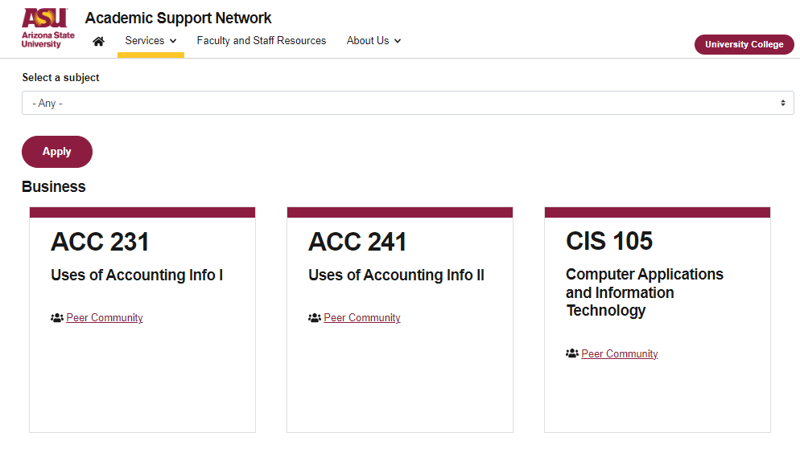

More Questions?
Check out our other resources!
tutoring.asu.edu/online-study-hub
Don’t forget to check out the Online Study Hub for additional resources!

Slide 33
Additional Resources
Course Repo
Course Discord
BMP File Format (Wiki)
Linux Kernel API

